Slide 1



AI-Powered Smart Controller for a Hybrid Microgrid
A "Green Skills" Project for the Shell-Edunet Skills4Future AICTE Internship
Presented By : Sanjana Sudhakar Dhabale
AICTE Student ID : STU676aa333947fe1735041843
Internship ID : INTERNSHIP_175683301568b724f7b9fba

Slide 2
Learning Objectives
Apply Machine Learning (XGBoost) to solve a complex time-series forecasting problem for three different variables (Solar, Wind, and Load).
Build a complete end-to-end ML pipeline : Data Preprocessing (Week 1) → Model Training (Week 2) → Simulation (Week 3).
Develop a complex decision-making algorithm (the "Smart Controller") that uses the model's predictions to manage a battery.
Evaluate the system's performance using both ML metrics (R² Score) and practical system metrics (Battery State of Charge, Grid Exchange).
Deploy the entire system as a live, interactive web application using Streamlit.
Source :
www.freepik.com/

Slide 3

Goal
To design and build an intelligent AI controller that accurately forecasts energy generation (Solar/Wind) and user demand (Load).
The system must use these forecasts to autonomously decide the most optimal action (Charge Battery, Discharge Battery, or Buy/Sell from Grid) to ensure the microgrid remains stable, reliable, and cost-effective.
GOAL
Source :
www.freepik.com/

Slide 4
Tools and Technology used
Programming Language : Python
Data Handling & Analysis : Pandas, NumPy
Machine Learning :
    Scikit-learn : For StandardScaler and train_test_split.
    XGBoost : The high-performance gradient boosting model used for all 3 prediction tasks.
Visualization : Matplotlib, Seaborn (for analysis) & Plotly (for the interactive app).
Deployment : Streamlit (for building and hosting the web app).
Model Management : Joblib (for saving and loading the trained .joblib models).

Slide 5
Methodology
Week 1 : Data Preprocessing & Visualization
Task : Data Importing, Pre-Processing, and Visualization.
Action : Loaded and cleaned the raw dataset with Pandas. Performed Exploratory Data Analysis (EDA) to visualize daily and seasonal patterns of solar, wind, and load. Engineered new features (e.g., lag, rolling averages) to improve model accuracy.

Slide 6
Methodology
Week 2 : Model Selection & Building
Task : Model Selection & Building.
Action : Trained and evaluated multiple algorithms (Linear Regression, Random Forest, XGBoost). Selected XGBoost Regressor as the champion model for all three targets due to its superior R² score (over 0.96 for all models).

Slide 7
Methodology
Week 3 : Simulation & Deployment
Task : Controller Simulation & Deployment.
Action : Built a "Smart Controller" algorithm in Python. Used the 3 trained models to generate forecasts, which the controller used to simulate optimal battery and grid decisions. Deployed the final controller as a Streamlit web app.

Slide 8
Problem Statement
Hybrid renewable energy systems (solar/wind) are unstable due to unpredictable weather and variable user demand. This leads to power instability, unnecessary stress on the battery, and energy wastage.

Slide 9
Solution
An AI-powered system that forecasts these variables. It uses the predictions to create an intelligent battery charging/discharging strategy, effectively balancing the grid, protecting the battery, and ensuring an uninterrupted power supply.

Slide 10
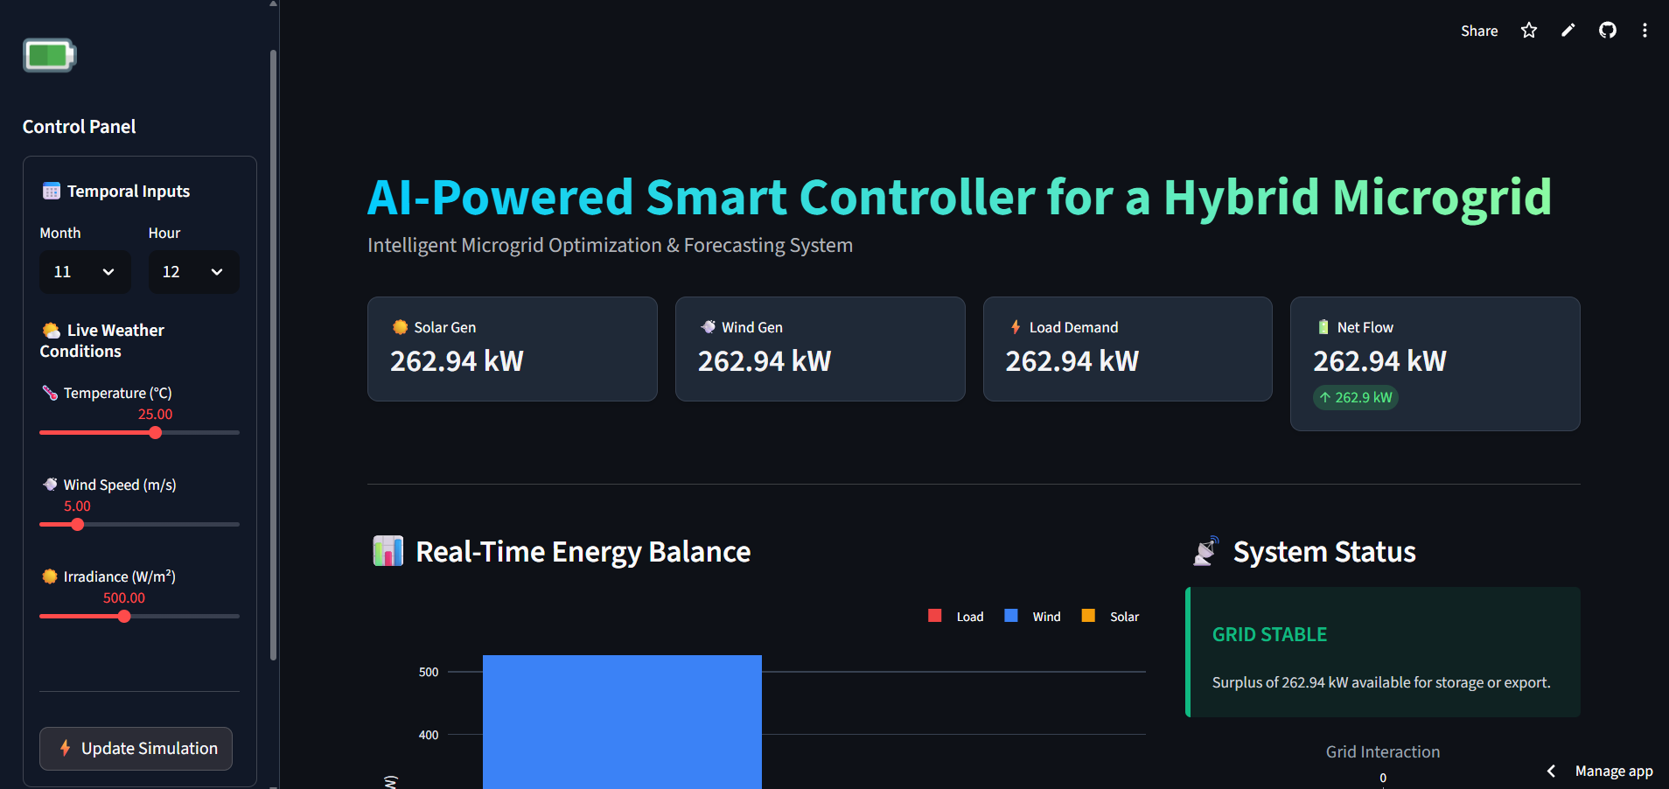
Screenshot of Output
The Live Application

Slide 11
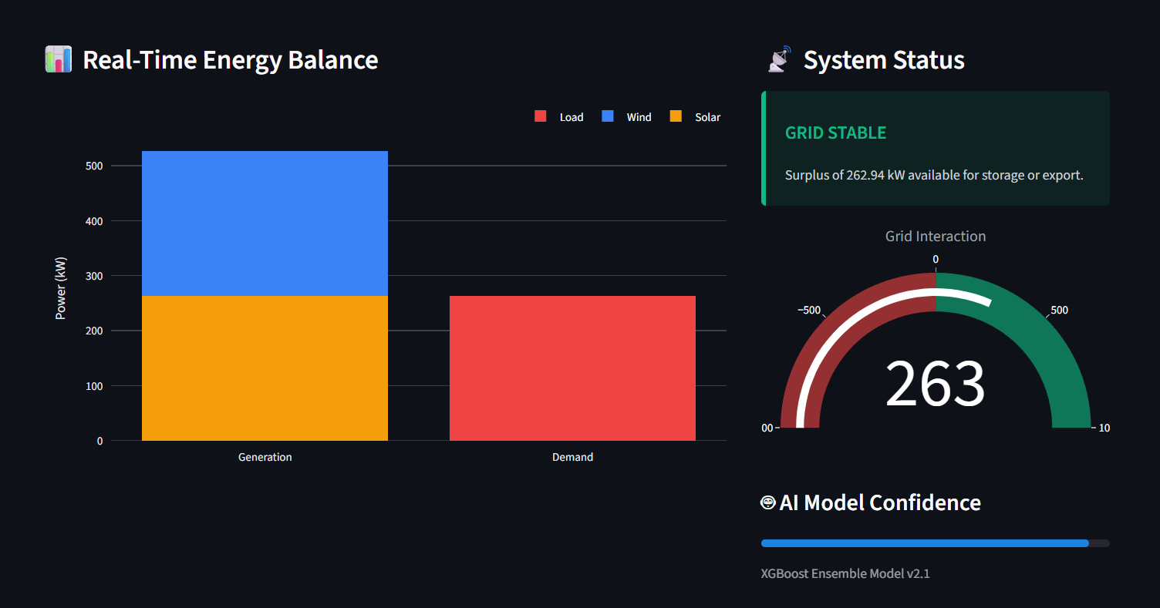
Screenshot of Output
The Live Application

Slide 12
Conclusion
Impact : This project demonstrates a "Green Skills" solution, proving that AI can solve grid stability issues. The controller optimizes battery life and reduces grid dependency, making renewable energy more reliable.
Educational Value : I successfully built a complete end-to-end ML pipeline: from raw data cleaning (Week 1) to model training (Week 2) and finally to a complex simulation and live web deployment (Week 3).
Next Steps :
Integrate a live Weather API (like OpenWeatherMap) to use real-time data instead of historical.
Deploy the Python script on a hardware device (like a Raspberry Pi) to control a physical battery system.
Live App Link : https://hybrid-microgrid-controller.streamlit.app/
Project Repository : https://github.com/DhammadeepRamteke/hybrid-microgrid-controller

